Slide 1

BASIC ELECTRICAL AND ELECTRONICS ENGINEERING
Course Code: CSE1002
SCHOOL OF COMPUTER SCIENCE ENGINEERING AND APPLICATIONS
Mrunmayee Rahate
Assistant Professor, DYPIU

Slide 2
Module 1: Fundamentals of Electrical Circuits
Lecture 3:
Source Transformation, Kirchhoff’s Laws

Slide 3
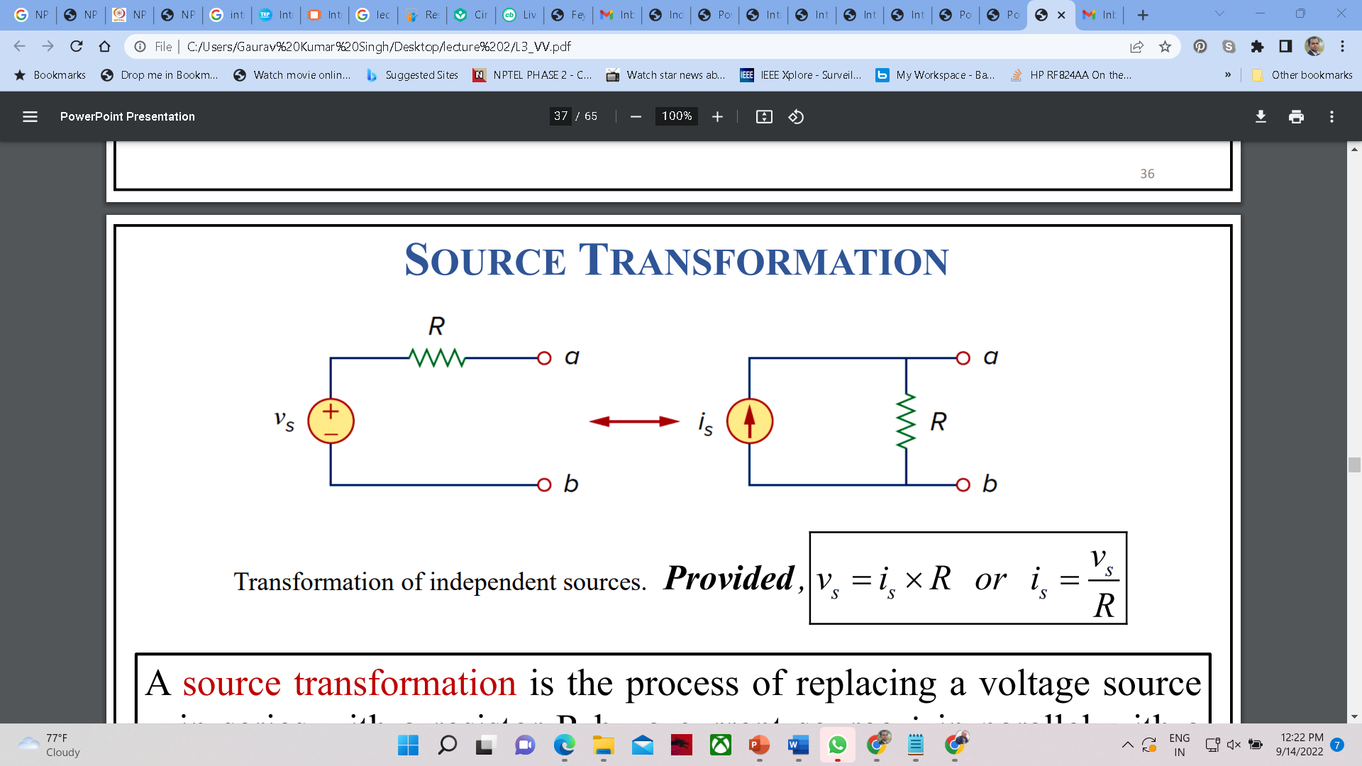
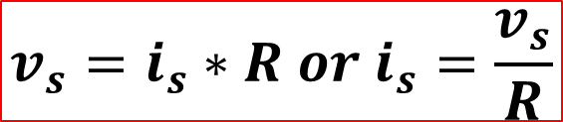
SOURCE TRANSFORMATION
Transformation of independent sources
$$v_{s}=i_{s}∗R or i_{s}=\frac{v_{s}}{R}$$
A source transformation is the process of replacing a voltage source $v_{s}$ in series with a resistor $R$ by a current source $i_{s}$ in parallel with a resistor $R$, or vice versa.
Notes:
Source transformation allows you to convert between two equivalent representations of a source + resistor combination:
Voltage Source → Current Source:
A voltage source vs in series with a resistor R can be transformed into a current source is in parallel with the same resistor R.
Given: Voltage source vs, Series resistor R
Transformation:
is = vs*R
The new circuit has a current source is in parallel with R.
Current Source → Voltage Source:
A current source is in parallel with a resistor R can be transformed into a voltage source vs in series with R.
Given: Current source is, Parallel resistor R
Transformation:
vs = is*R
The new circuit has a voltage source vs in series with R.
Why It Works:
Both circuits present the same voltage-current behaviour at the terminals (a-b):
If you measure voltage and current at terminals a-b, you’ll get the same result in both configurations.
That means they are electrically equivalent or Thevenin/ Norton equivalents.

Slide 4
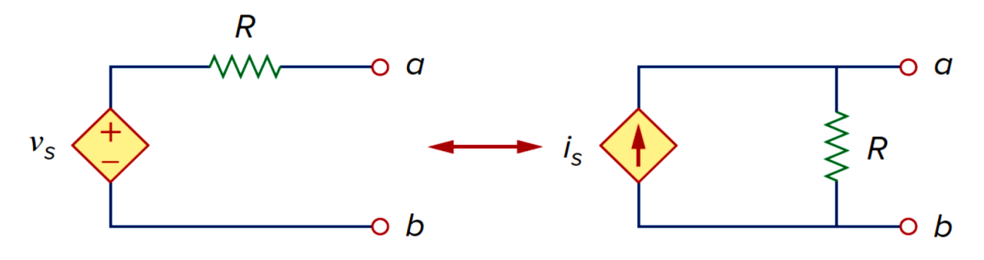
Source transformation also applies to dependent sources.
A source transformation does not affect the remaining part of the circuit.
One should keep the following points in mind when dealing with source transformation:
The arrow of the current source is directed toward the positive terminal of the voltage source.
Source transformation is not possible when R = 0, which is the case with an ideal voltage source. However, for a practical, non-ideal voltage source, R ≠ 0.
Similarly, an ideal current source with R = ∞ cannot be replaced by a finite voltage source.
Notes:
Source transformation is also valid when dealing with dependent (controlled) sources, not just independent ones.
Source Transformation with Dependent Sources
The voltage source vs shown on the left is a dependent (controlled) voltage source in series with a resistor R.
It is transformed into a dependent current source is in parallel with the same resistor R.
Rule remains the same:
vs = is*R or is = vs*R
This transformation does not affect the dependent nature of the source — it remains dependent on some variable elsewhere in the circuit.
Source Transformation Does Not Affect the Rest of the Circuit
This transformation only affects the local part of the circuit (i.e., the source and resistor). All other elements connected to the terminals a and b remain unaffected in terms of behaviour.
Important Considerations for Source Transformation
1. Direction of the Current Source Arrow
The arrow of the current source is directed toward the positive terminal of the voltage source. This ensures that the polarity and direction of power are preserved after transformation. It maintains the equivalence between the two configurations in terms of voltage-current relationships.
2. Not Possible When R=0
If R=0, then you're dealing with an ideal voltage source. An ideal voltage source cannot be converted into a current source. In practical cases, real voltage sources have non-zero internal resistance R≠0, so transformation is possible.
3. Not Possible When R=∞
This represents an ideal current source, where the resistance is effectively open circuit. A current source in parallel with R=∞ cannot be converted into a voltage source with finite voltage.

Slide 5
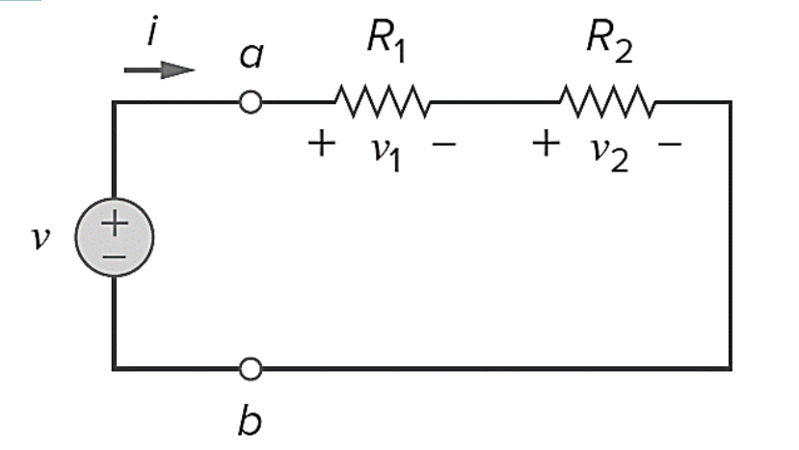



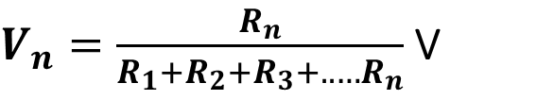


VOLTAGE DIVISION
The total voltage gets divided in series circuit while the current flowing through every element is the same. Hence, voltage division is applicable in series circuit.
The voltage division rule can be understood by considering a series circuit shown below.
The voltages across series resistors are,
$i=\frac{v}{\left(R_{1}+R_{2}\right)}$ (1)
$v_{1}=i∗R_{1}$ (2)
$v_{2}=i∗R_{2}$ (3)
Putting (1) in (2), Voltage drop across $R_{1}$
$v_{1}=\frac{R_{1}}{\left(R_{1}+R_{2}\right)}v$ (4)
Putting (1) in (3), Voltage drop across $R_{2}$
$v_{2}=\frac{R_{2}}{\left(R_{1}+R_{2}\right)}v$ (5)
V is divided among the resistors in direct proportion to their resistance. Larger the resistance, larger is voltage drop. This is called the principle of voltage division.
For n resistors in series, voltage across nth resistor is given by,
$V_{n}=\frac{R_{n}}{R_{1}+R_{2}+R_{3}+..…R_{n}}$ V
Notes:
Voltage Division
In a series circuit, the same current flows through all components. However, the total voltage across the series circuit gets divided across each resistor in proportion to its resistance.
Voltage Division Rule (Using 2 Resistors)
A voltage source v is applied across two resistors, R1 and R2, connected in series.
Let the voltage drops across R1 and R2 be v1 and v2 respectively.
Voltage drop across R1:
$v_{1}=\frac{R_{1}}{\left(R_{1}+R_{2}\right)}v$
Voltage drop across R2:
$$v_{2}=\frac{R_{2}}{\left(R_{1}+R_{2}\right)}v$$
Interpretation:
Voltage is divided in proportion to resistance.
The larger the resistor, the greater its share of the total voltage.
General Formula (For n Resistors in Series)
If you have n resistors R1,R2,…,Rn in series with a total voltage V, then the voltage across the nth resistor is:
$V_{n}=\frac{R_{n}}{R_{1}+R_{2}+R_{3}+..…R_{n}}$ V

Slide 6
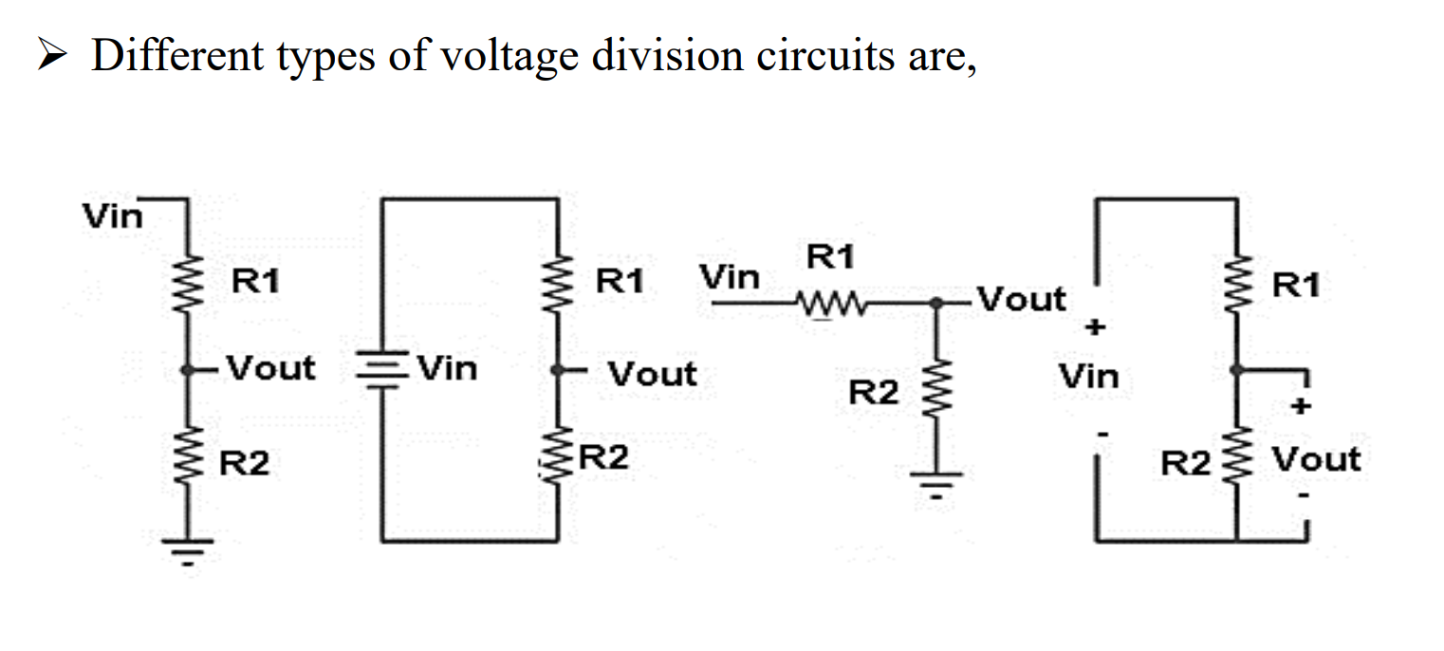

Slide 7
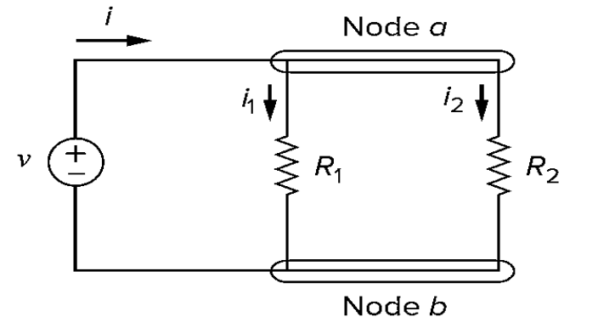


CURRENT DIVISION
The total current gets divided in parallel circuit while the voltage across each element is the same. Hence, current division is applicable in parallel circuit.
The current division rule can be understood by considering a parallel circuit shown below.
$$i_{1}=\frac{iR_{2}}{R_{1}+R_{2}}$$
$$i_{2}=\frac{iR_{1}}{R_{1}+R_{2}}$$
Total current I is shared by the resistors in inverse proportion to their resistances. This is known as the principle of current division.
Notes:
Current Division
Current Division is a method used in electrical circuits to determine how current divides between multiple branches that are connected in parallel.
Use the current division rule when you have parallel resistors, and you know the total current entering the parallel network.
In a parallel circuit, the voltage across each branch is the same and the current divides inversely proportional to the resistance of each branch. That is, lower resistance gets more current, and higher resistance gets less.
Formula:
If two resistors R1 and R2 are in parallel and a total current i enters the junction, then:
Current through R1:
$$i_{1}=\frac{iR_{2}}{R_{1}+R_{2}}$$
Current through R2:
$$i_{2}=\frac{iR_{1}}{R_{1}+R_{2}}$$
Notice that each current is proportional to the resistance of the other branch, due to the inverse relationship.

Slide 8
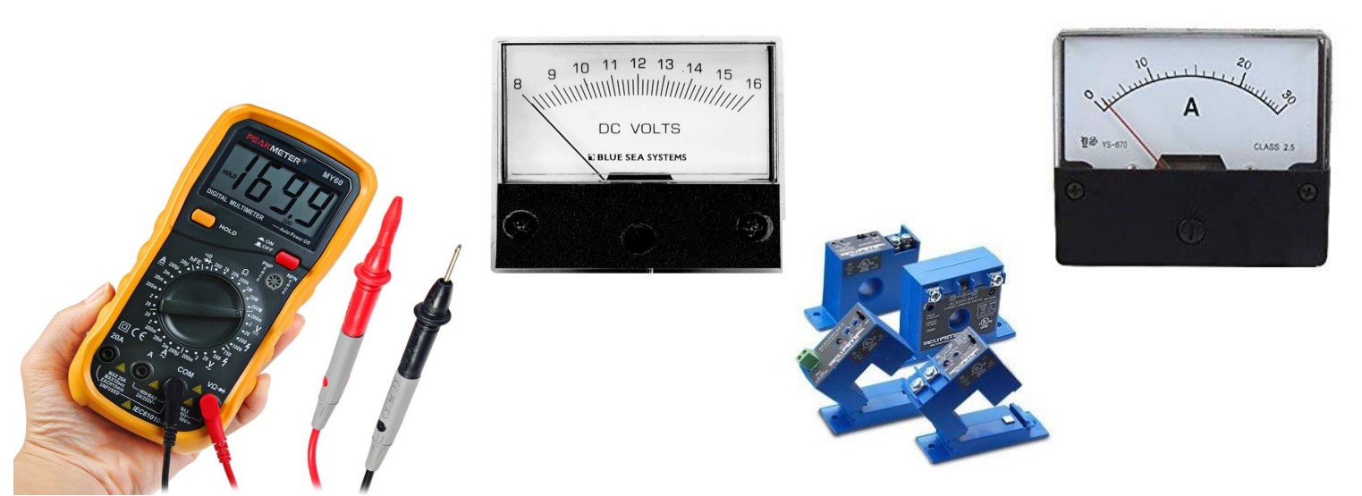
Current/ Voltage Division finds applications in construction of electric meters and sensor devices

Slide 9
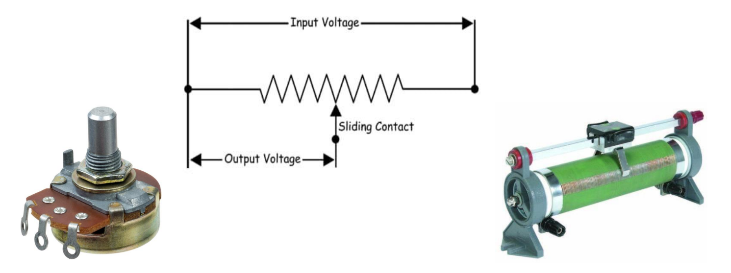
Voltage division concept is used in making rheostat, potentiometers

Slide 10
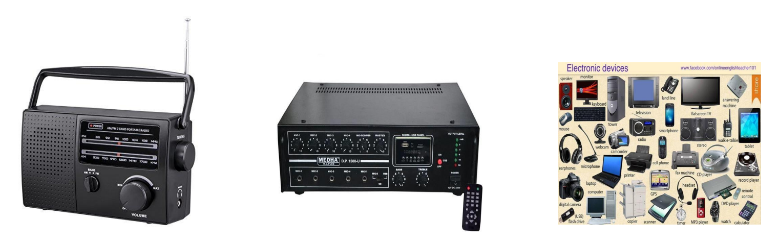
Voltage division concept is used in making radios, amplifiers and electronic devices for adjusting signal levels

Slide 11
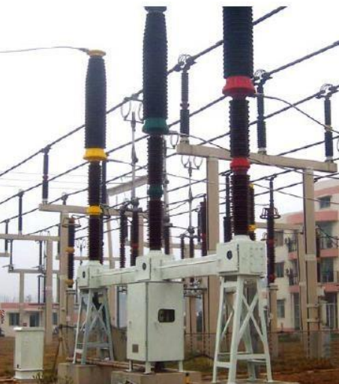
Principal of voltage division and current division is used in potential transformers and current transformers for stepping down high voltage and high current in power plants

Slide 12
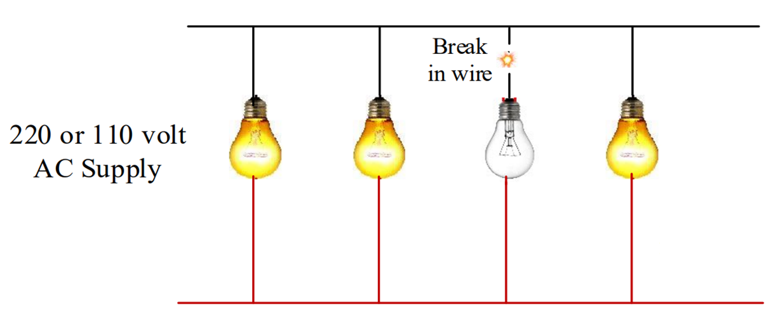
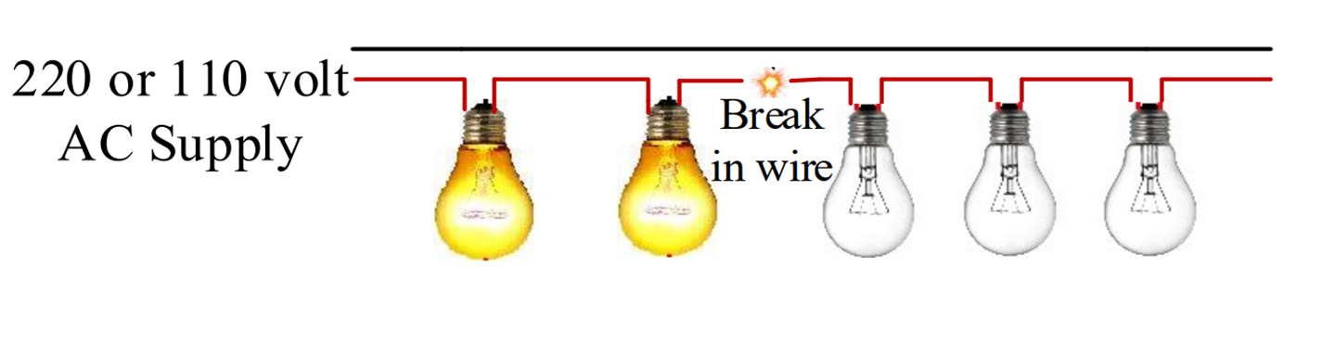
Lighting System
Rest of the bulbs are ON except the parallel path with break in circuit.
Rest of the bulbs are OFF after breaking point. Lighting System Series Connection Correct?
X
No! These 2 bulbs will also be OFF. There will be no current on the entire line because of open circuit.

Slide 13
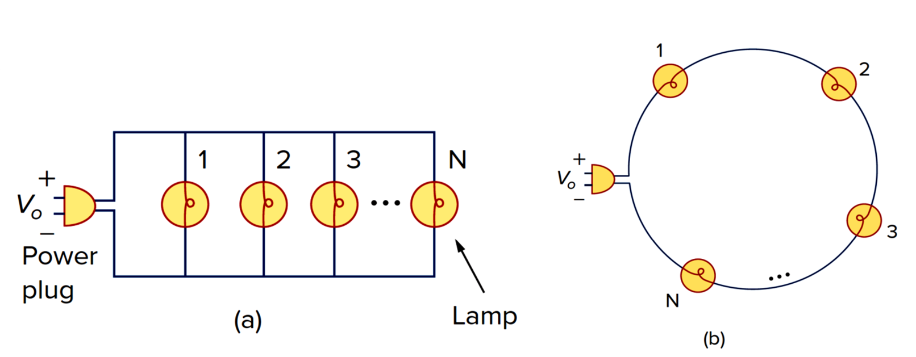
Lighting System Circuit Representation
(a) Parallel connection of light bulbs (b) series connection of light bulbs.

Slide 14
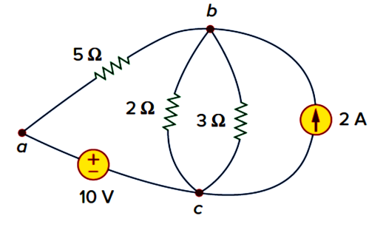
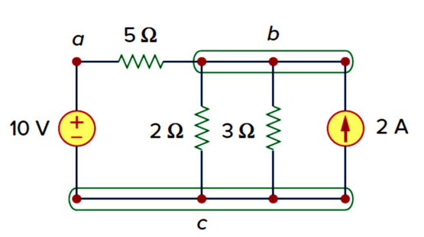

NODE , BRANCHES AND LOOPS
A branch represents a single element such as a voltage source or a resistor in a circuit.
A node is the point of connection between two or more branches
A loop is any closed path in a circuit.
Same Circuit reconfigured
5 branches and 3 nodes
A network with b branches, n nodes, and l independent loops will satisfy the fundamental theorem of network topology:
$$b=n+l−1$$
Notes:
Branch: A branch is a single, continuous electrical component. This can be a voltage source, a current source, a resistor, a capacitor, an inductor, or any other two-terminal element. Each branch represents a single path for current to flow.
Node: A node is a point in a circuit where two or more branches connect. It's a point of common potential. All points along a single connecting wire, even if it's bent, constitute a single node. The key idea is that the voltage is the same at every point on a given node.
Loop: A loop is any closed path in a circuit. Starting from a point and tracing a path through a series of branches and nodes, a loop is completed when you return to your starting point without crossing any intermediate node or branch more than once.
The Fundamental Theorem of Network Topology
b=n+l−1
where:
b is the number of branches.
n is the number of nodes.
l is the number of independent loops.
This equation is a fundamental relationship in graph theory applied to electrical circuits. It states that the number of branches in a connected network is directly related to the number of nodes and independent loops.
The fundamental theorem of network topology (b=n+l−1) is a powerful tool because it directly links the number of equations needed for KCL (n−1) and KVL (l) for any given circuit. It confirms that both methods, despite their different approaches, yield the same number of independent equations and, therefore, provide a complete solution for the circuit variables (all branch currents and voltages).

Slide 15
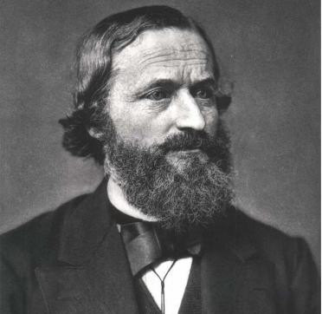
KIRCHHOFF’S LAWS
Kirchhoff’s laws are two equalities that deal with the current and voltage in electrical circuits.
They were first described in 1845 by German physicist Gustav Kirchhoff.
Ohm’s law by itself is not sufficient to analyze circuits.
When it is coupled with Kirchhoff’s laws, we have a sufficient, powerful set of tools for analyzing a large variety of electric circuits.
Kirchhoff’s current law is based on the law of conservation of charge.
Kirchhoff’s voltage law is based on the law of conservation of energy.
Kirchhoff's laws can be applied to AC circuits in the same way as for DC circuits provided we use phasor sums rather than algebraic sums.
Notes:
Kirchhoff's Current Law (KCL)
KCL is based on the principle of conservation of charge. It states that the algebraic sum of all currents entering and leaving a node (or junction) in an electrical circuit must be equal to zero. This is because charge cannot accumulate at a node; it must be conserved.
Currents entering the node are typically assigned a negative sign, while currents leaving are assigned a positive sign.
Kirchhoff's Voltage Law (KVL)
KVL is based on the principle of conservation of energy. It states that the algebraic sum of all potential differences (voltages) around any closed loop in a circuit is equal to zero. This is because, for a charge to return to its starting point in a closed loop, the net change in its potential energy must be zero. The energy supplied by sources must equal the energy dissipated or stored by other components.
Voltage rises (e.g., across a battery from the negative to the positive terminal) are typically positive, while voltage drops (e.g., across a resistor in the direction of current flow) are negative.

Slide 16
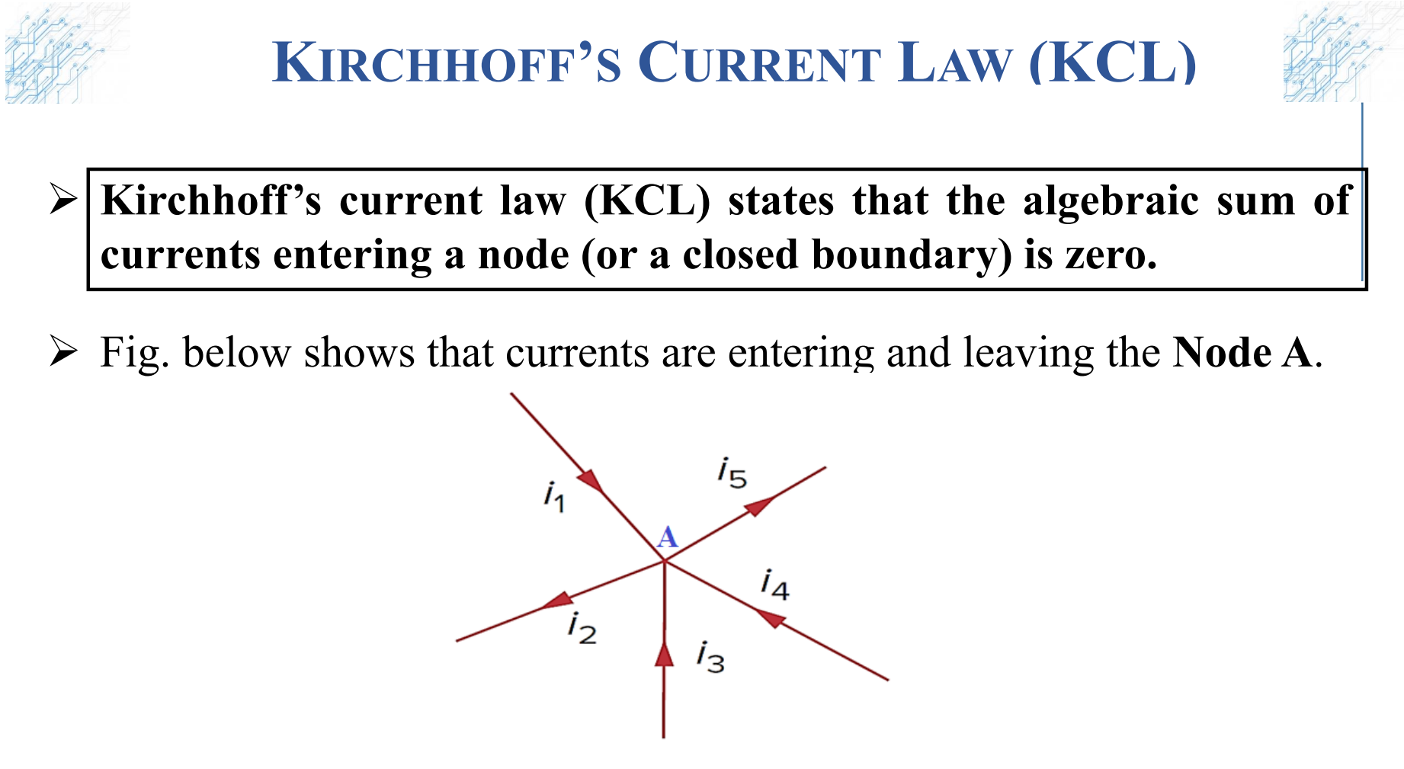

Slide 17
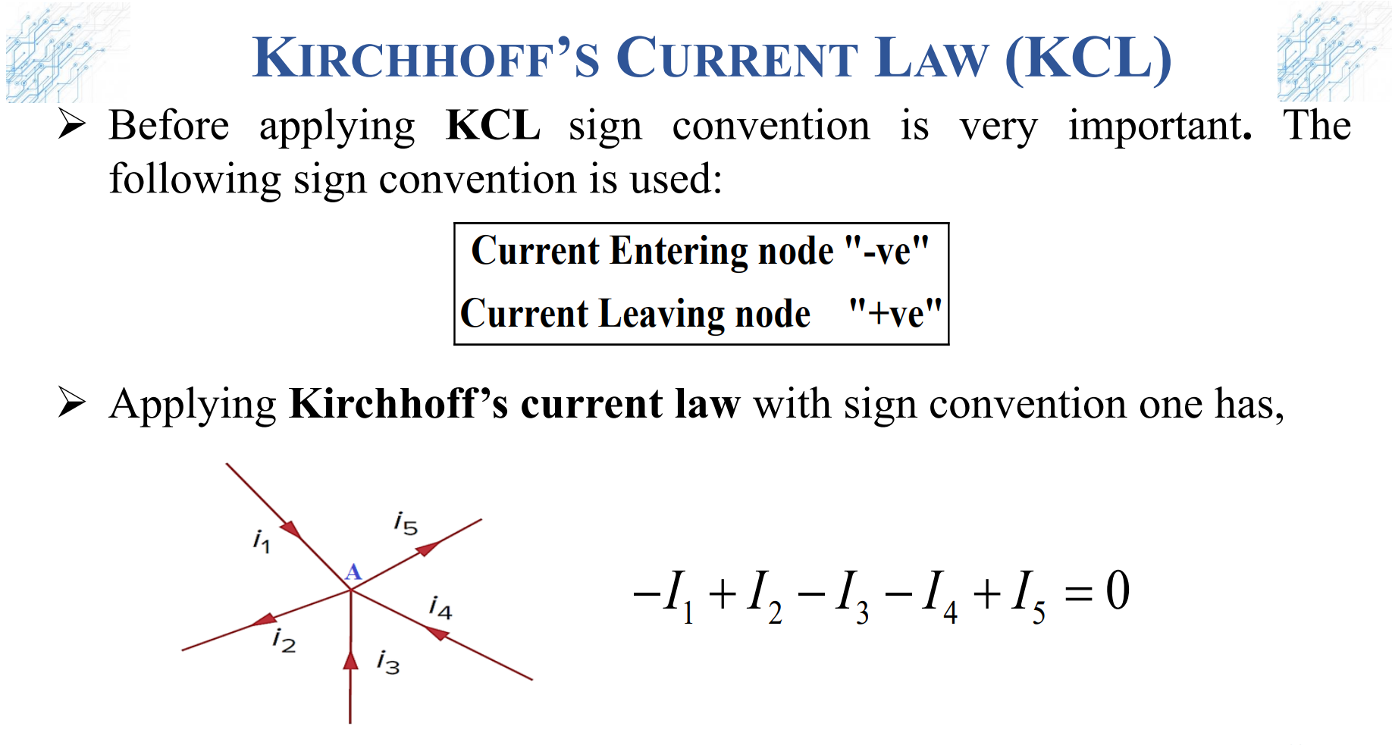

Slide 18
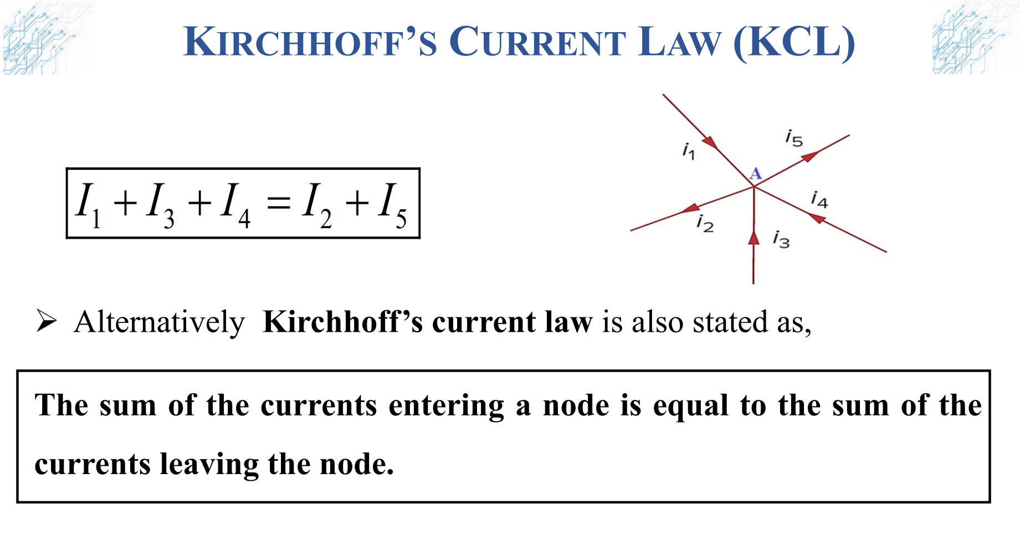

Slide 19
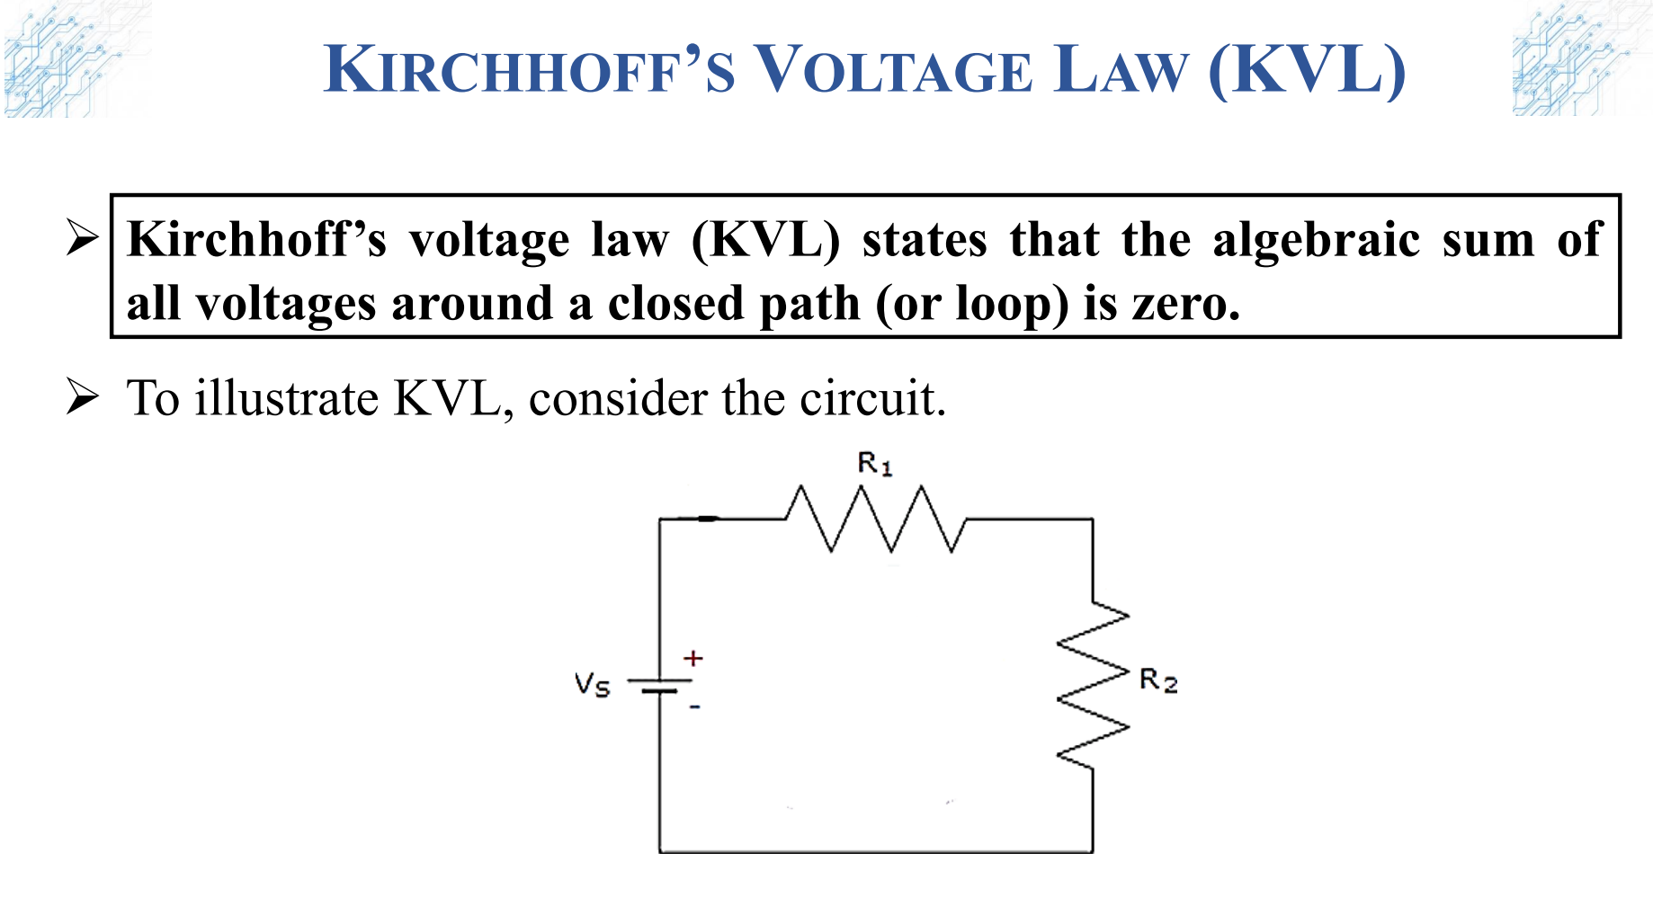

Slide 20
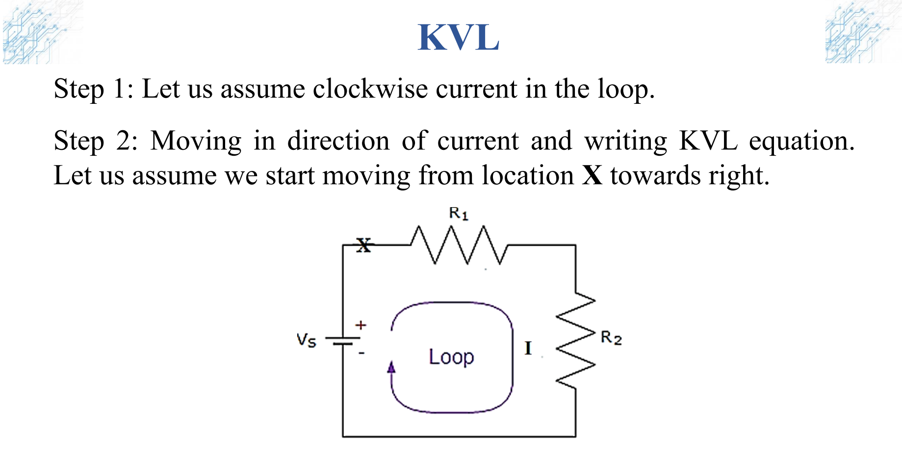

Slide 21
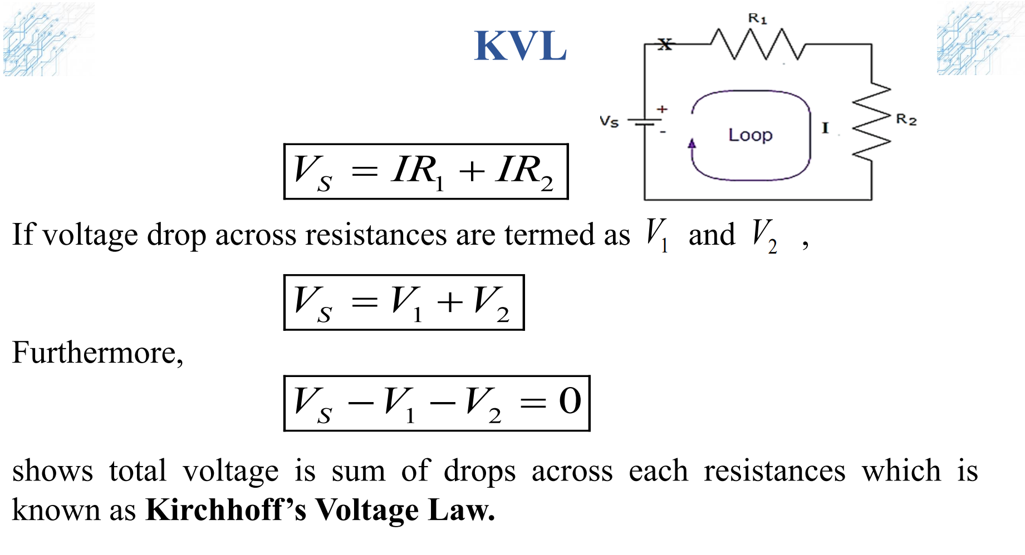

Slide 22
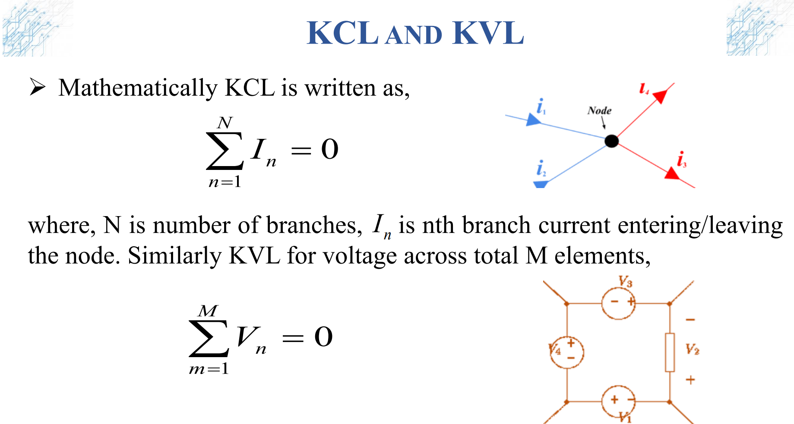

Slide 23
Thank You !!!

